Slide 1
Machine Learning SVM, SVM & SVM!!!
M V Sai Sriram
MT2012160
Yogesh Navik
MT2012086

Slide 2
Work Accomplished
SVM
Digit Recognition
Hard Margin
Linear Kernel
Multiclass SVM
Linear Kernel
One vs One
92 % on avg
Poly Kernel
Accelerometer
Biometric
Multiclass SVM
Linear Kernel
Max 97.54%
Poly Kernel
Rbf Kernel
Max 55.13%

Slide 3
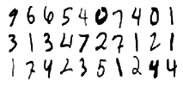
Digit Recognizer
Input:
Train: Image of dimensions 28x28,
Test:
Feature Space:
784 pixels each taking intensity in the interval [0, 255]
Objective: Classify the possible 10 digits among 28000 given testing samples.
Approach: Multiclass SVM with linear, poly kernels

Slide 4
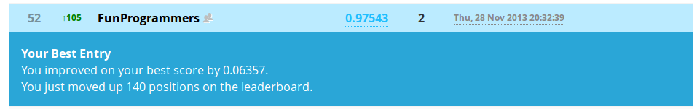
Digit Recognizer Results: Justification:

Slide 5
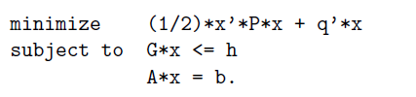



Our own Implementation of SVM:
One vs One Classifier
Quadratic Programming Problem
Format of a quadaratic programming problem in cvxopt:
Using Dual parameters to obtain primal solution
Dual form of SVM:

Slide 6
Our own Implementation of SVM, Results:

Slide 7
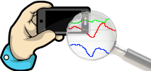
Accelerometer Biometric
Input:
Train: Time series data collected from several devices
Test: Sequence associated time series data from several devies
Feature Space: Distribution (Variance, Co Variance, Median in different axes)
Objective: Associate each sequence id with it’s relative device id
Approach: Multiclass SVM with linear, poly and Rbf kernel

Slide 8
Accelerometer Biometric (Results): Justification:

Slide 9
Work Accomplished (to summarize):
SVM
Digit Recognition
Hard Margin
Linear Kernel
Multiclass SVM
Linear Kernel
One vs One
92 % on avg
Poly Kernel
Accelerometer
Biometric
Multiclass SVM
Linear Kernel
Max 97.54%
Poly Kernel
Rbf Kernel
Max 55.13%

Slide 10
Technologies Used:
Database: Mysql with Tokudb engine
Sklearn toolkit
Numpy, scipy
cvxopt

Slide 11
Thank You!!!

